Slide 1
Lecture 9, Fall 2016: A note about comparing Strings
Use the .equals operator to compare two strings:
(see the StringCompare demo program)
If (license1.equals(license2) ) { // found }
Do not use == for Strings, as that compares memory locations.
String str1 = new String(“Hi”);
String str2 = new String(“Hi”);
If (str1 == str2 ) {System.out.print(“Match”)
else System.out.print(“Not a match”).

Slide 2
Array Implementation of Queues
Reminder: test Friday 10/21/2016.
First, a review of the MOD operator ( % ):
x % y is the remainder of x / y
Ex:13 mod 6: 13 % 6 = 2 remainder 1
Digital clock:
What is the mod for each digit?

Slide 3
Array Implementation of Queues
Operations:
void ENQ(T item); // add to end of Q
T item = DEQ( ); // remove first item
boolean isFull( ); //
boolean isEmpty( ); //
Keep track of the Front&Back of the Q.
0 1 2 3 4
A | B | C | D

Slide 4
Try # 1: Fix “myfront” at location zero in array
Need an index to the back of the queue
ENQ(“A”); ENQ(“B”); ENQ(“C”);
No problem on ENQ operations
myfront always =0; myback = 2
DEQ an item – O(1) or O(N) ?
0 1 2
A | B | C
myFront
← myBack →

Slide 5
Try # 2: Fix “myback” at location zero
Need an index to the front of the queue
ENQ(“A”); ENQ(“B”); ENQ(“C”);
ENQ? O(1) or O(N) ?
myback always=0; myfront=2;
Item = DEQ( ); // O(1) or O(N) ?
0 1 2 3
C | B | A
myBack
← myFront →

Slide 6
Try # 3: Let front and back grow freely
Need indices to front and back of the queue
myfront = myback = 0; // need count var
ENQ operations (incr myback)
ENQ(“A”); ENQ(“B”); ENQ(“C”);
ENQ: O(1) or O(N) ?
myback =2; myfront=0;
A | B | C
← myFront →
← myBack →

Slide 7
Try # 3: Let front and back grow freely
DEQ operations: (incr myfront)
Item1 = DEQ( ); Item2 = DEQ( );
myback =2, myfront = 2;
What happens as we keep adding & deleting?
Problem!
0 1 2 3 4
 |  | C
← myFront →
← myBack →

Slide 8
Problems with try# 3
Additions to the queue would result in incrementing myback.
Deletions from the queue would result in incrementing myfront.
Clearly, we’d run out of space soon!

Slide 9
Solutions to try# 3
Shift the elements downward with each deletion (YUCK!!)
Viewing array as a circular buffer, i.e. wrapping the end to the front ☺

Slide 10
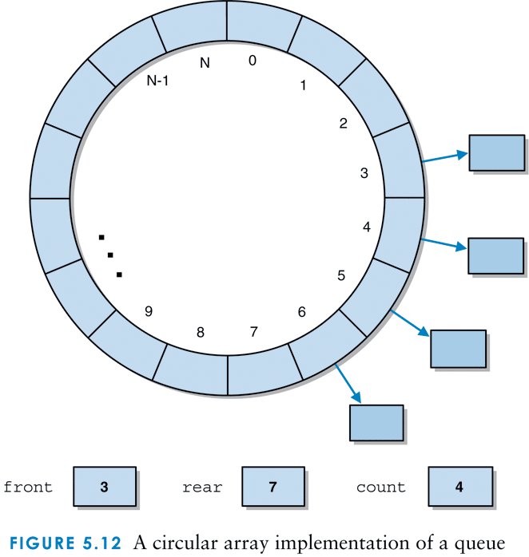
A circular array implementation of a queue

Slide 11
Try #4:“Circular” Array

Slide 12
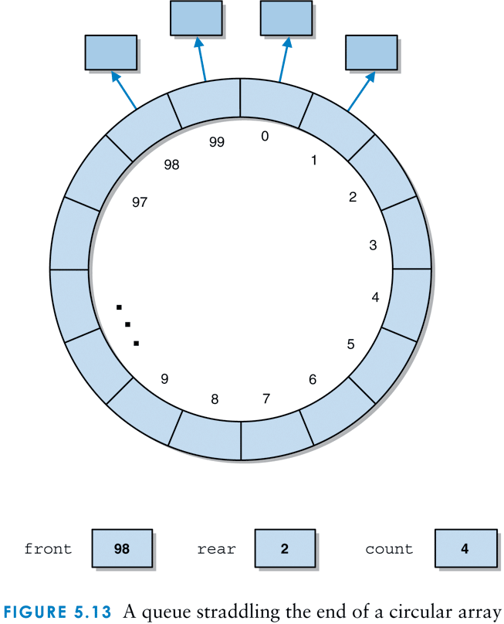
A queue straddling the end of a circular array

Slide 13
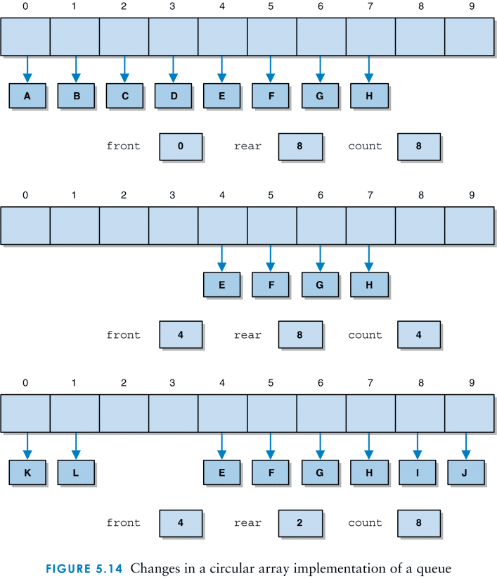
Changes in a circular array implementation

Slide 14
“Circular” Array: Implementation

Slide 15
Empty vs Full ? Count variable or Empty Slot
Keep an empty slot between myfront and myback, store only CAPACITY-1 items.
Empty: myfront==myback
Full: (myback+1) % capacity == myfront
OR: Keep an auxiliary counter to track actual number of elements in queue
Count: Zero = empty, Capacity= full

Slide 16
Notes about the following code
Problem: if we filled the entire array then myback would equal myfront: empty case.
One slot in array must be left unfilled so that we can distinguish between an empty array and a full one.
Remember myback points to last item +1.
So, we set CAPACITY as usual, but can only store CAPACITY -1 items in array.

Slide 17
Circular Queues: ENQ and DEQ
 | ENQ( ) | DEQ( item)
Notes: | If not Full, Put item in array[myBack] then INCREMENT myBack | If not Empty, Item = array[myFront] Then INCREMENT myFront

Slide 18
Circular Queues:Empty vs Full
Empty ( ) | Full( )
Return TRUE if myFront = = myBack | Return TRUE if (myBack+1) % CAPACITY = = myFront

Slide 19
How fast ??
The enqueue operation is O(1) for both implementations
The dequeue operation is O(1) for linked and circular array implementations, but O(n) for the noncircular array version due to the need to shift the elements in the queue
Circular Queue worksheet
no Count variable
Stores Capacity -1 elements.

